Slide 1
Departures and Variances
Kansas City, MO
February 25, 2016

Slide 2
Position of Sentences in Relation to Guideline Range National - FY 2014
Non-Govt Below 21.4%
Within Guideline Range 46.0%
§5K3.1 & Other Govt 17.6%
§5K1.1 12.8%
Above Guideline Range 2.2%
SOURCE: 2014 Sourcebook of Federal Sentencing Statistics; 75,836 Cases Sentenced

Slide 3
Position of Sentences in Relation to Guideline Range Western Missouri - FY 2014
Non-Govt Below 25.6%
Within Guideline Range 41.7%
§5K3.1 & Other Govt 8.2%
§5K1.1 21.3%
Above Guideline Range 3.1%
SOURCE: 2014 Sourcebook of Federal Sentencing Statistics; 830 Cases Sentenced

Slide 4
Position of Sentences in Relation to Guideline Range Kansas - FY 2014
Non-Govt Below 13.6%
Within Guideline Range 37.3%
§5K3.1 & Other Govt 26.3%
§5K1.1 19.6%
Above Guideline Range 3.1%
SOURCE: 2014 Sourcebook of Federal Sentencing Statistics; 675 Cases Sentenced

Slide 5
Statement of Reasons Form
AO Form 245(b)
Notes:
5
5

Slide 6
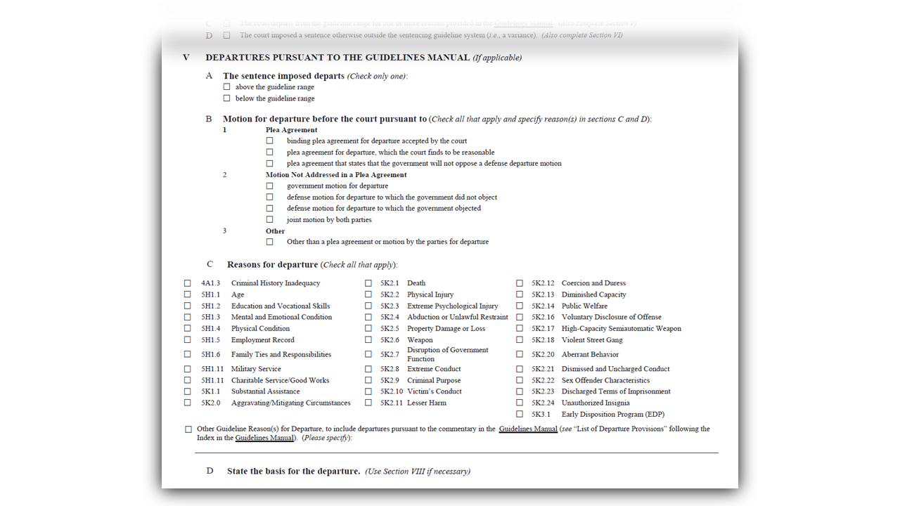
Statement of Reasons Form (SOR)
Page 2, Section V

Slide 7
Statement of Reasons Form (cont.)

Slide 8
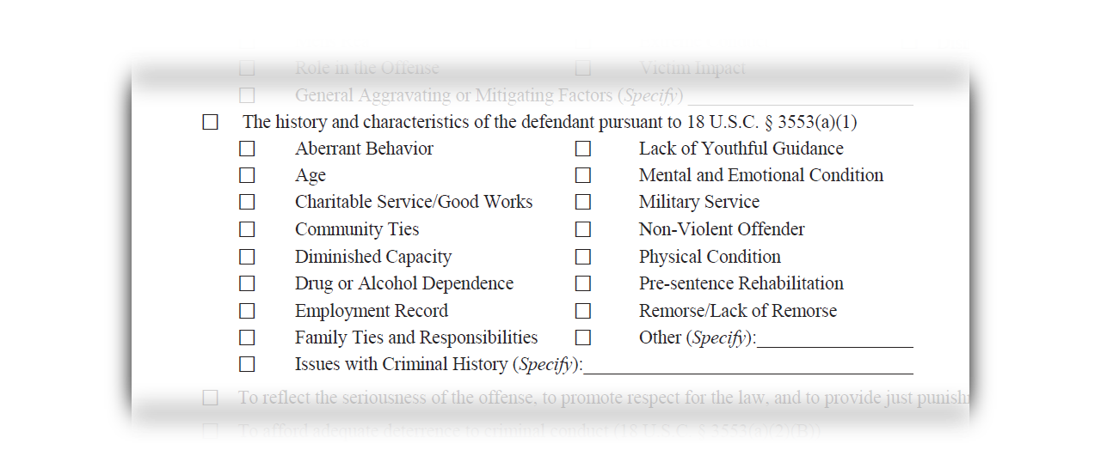
Statement of Reasons Form (cont.)
The History and Characteristics of the Defendant

Slide 9
Importance of the SOR
U.S. v. Duke, 788 F.3d 392 (5th Cir. 2015)
Allows for effective appellate review
Satisfies the Court of Appeals that the Court properly considered the defendant’s arguments
Demonstrates that the Court properly considered the relevant statutes governing sentencing
Explains why the District Court chose a particular sentence
The Commission extracts important data
*Note: if filed with the Court, it is filed under seal*
Notes:
9
9

