Slide 1
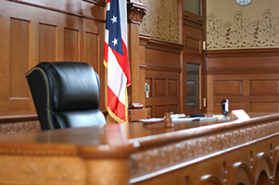
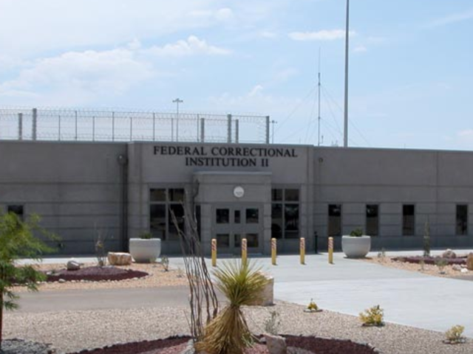
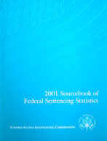
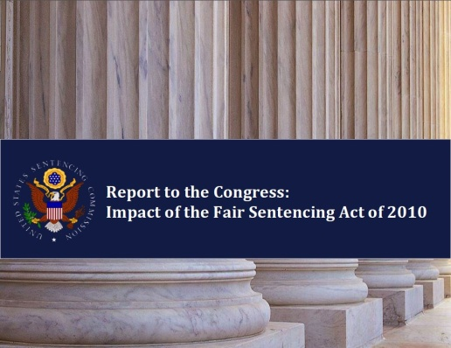
Sentencing Research / Sentencing Practice
Frank O. Bowman, III
Floyd R. Gibson Missouri Endowed Professor of Law

Slide 2
Guidelines origins
Original Guidelines levels were set in 1987 by reference to three benchmarks
In general, study of sentences imposed by federal judges in 10,000 cases
In drug cases, by reference to quantity-based minimums of Anti-Drug Abuse Act of 1986
In economic crime and some other case types, with the objective of raising historical judge-determined sentencing levels
Two of these three benchmarks were based on, or responded to, historical behavior of judges

Slide 3
Sentencing Commission research since 1987
For 29 years, most U.S. Sentencing Commission research has been self-referential and judge-based.
I.e., research has mostly been about
How the Guidelines are applied
Degree to which sentences imposed by judges are or are not within guidelines ranges and rules.
All of which has been useful, but …

Slide 4
Sentencing Commission research since 1987
Little Research on Sentencing Outcomes
Commission has done little outcomes research, i.e, research about effect of sentences on recidivism, communities, etc.
Until 2016, only recidivism research (2004-2005) related to criminal history scores as recidivism predictor
Unlike states, little interest in risk assessment
Little Research on Systemic Costs
Commission only began issuing prison impact analyses for its amendments in 2011-2012
Little Research Supporting Cost-Benefit Analysis

Slide 5
Notable exceptions
Cocaine reports to Congress
1995 Cocaine & Federal Sentencing Policy
2002 Cocaine & Federal Sentencing Policy
2007 Cocaine & Federal Sentencing Policy
Mandatory minimum sentencing reports
1991 Mandatory Minimum Penalties in the Federal Criminal Justice System
2011 Mandatory Minimum Penalties in the Federal Criminal Justice System
2016 Recidivism Study (unreleased)

Slide 6
Sentencing Commission research since 1987
Three possible explanations for limited character of Commission research:
Commission continued to accept idea that judicial decision-making is best metric for appropriate sentences; thus, judicial behavior is central component of feedback loop for guideline amendments.
Commission became guardian of own creation. Thus, judicial deviation from Guidelines seen as illegitimate behavior requiring enhanced discipline.
Particularly post-Booker, Commission has defended itself against Congress by seeking proof of Guidelines’ success as measured by judicial adherence.
BUT

Slide 7
What else should Commission be doing?
Refine and use prison impact model to issue standard-format reports evaluating budgetary cost and prison bed effect of any proposed guidelines amendment or sentencing legislation.
Improve risk-prediction tools .
Continue and refine new recidivism research.
Expand work on social costs of different crimes
Help evaluate proportionality of punishments
Refine resource allocation choices
Use all of above to do cost-benefit analyses of statutory and guidelines sentencing options.

Slide 8
Uses for the Commission research we have
Legislative policymaking

Slide 9
Sentencing Reform & Corrections Act of 2016 (SRACA)
Sentencing reform legislation which has passed Senate & House judiciary committees
Would lower sentences for some serving federal inmates and future defendants with mandatory minimum drug sentences
Conservative objection: SRACA would release “thousands of violent felons” who would commit more violent crimes

Slide 10
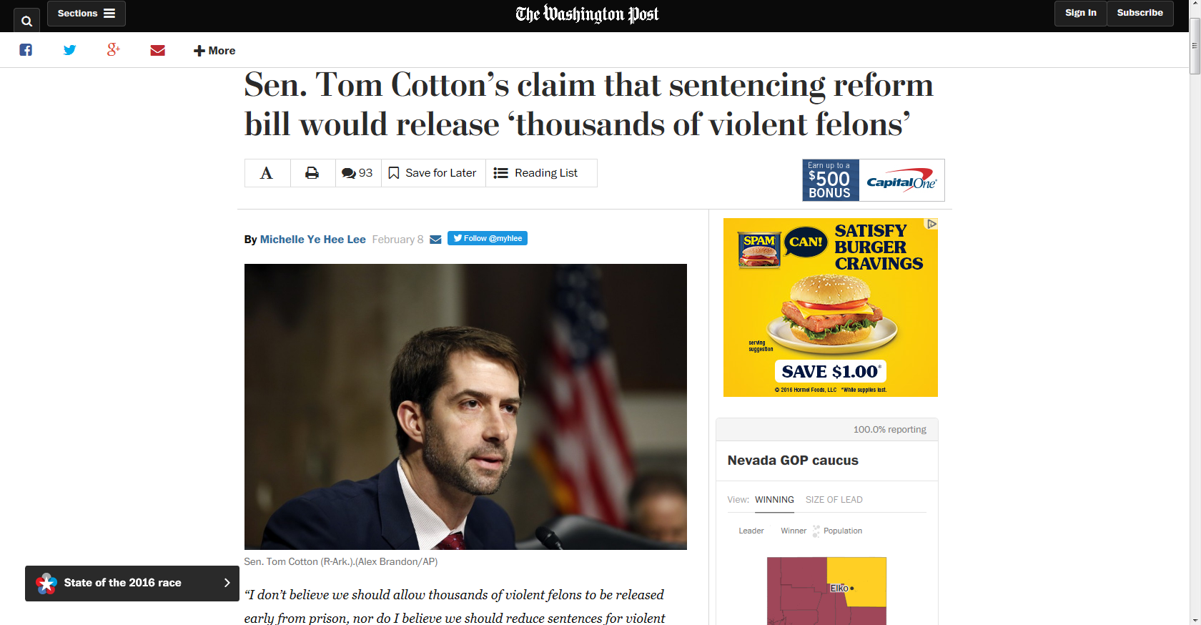
Sen. Cotton spokesperson: Drug traffickers are “violent felons”

Slide 11
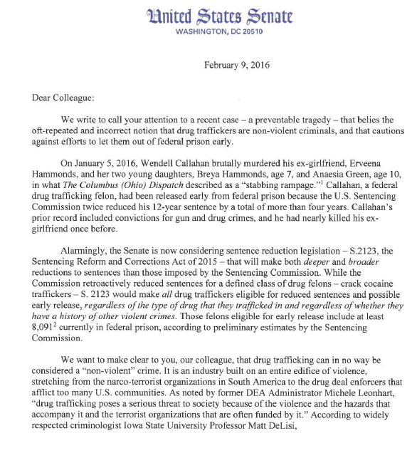
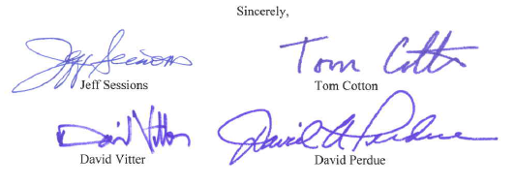
Proof: “a recent case”
“We want to make clear … that drug trafficking can in no way be considered a “non-violent” crime.”

Slide 12
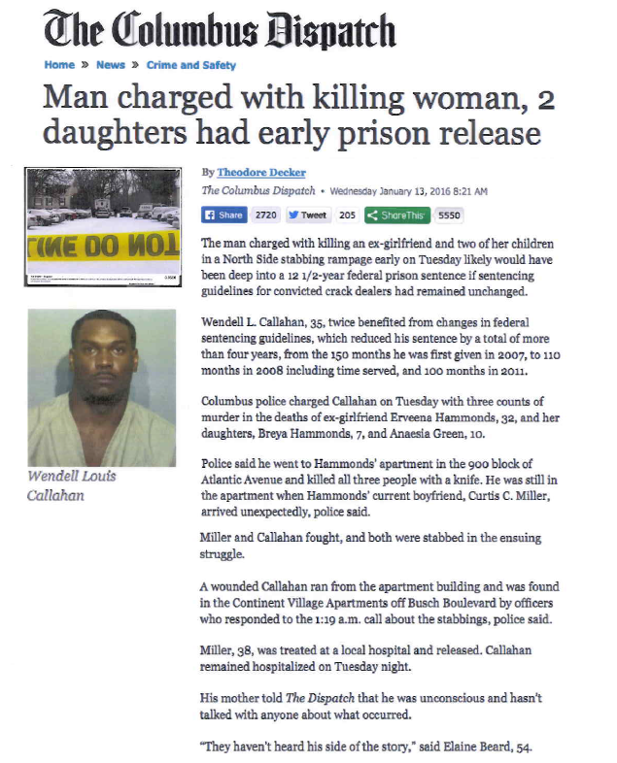
The “recent case”
Defendant serving time for crack offense released early
Fought with ex-girlfriend and killed her & daughters

Slide 13
Considered dispassionately, what is argument of SRACA opponents?
That persons convicted of drug trafficking (particularly those with mandatory minimum sentences) are “violent felons” – meaning persons especially disposed to commit violent crime.
Therefore, releasing prisoners serving mandatory minimum sentences for drug crimes presents an especially high risk that
These defendants will commit new crimes
That the new crimes will be violent
How can this argument be rationally assessed?

Slide 14
… a recidivism study
What questions would such a study need to ask?
(a) What is the recidivism rate (meaning rate of conviction of a new felony offense) for defendants who were convicted of a drug offense carrying a mandatory minimum sentence, but who were not subject to a firearms mandatory? (b) As to such defendants, what is the breakdown of offense types of which they were reconvicted? I.e., how many of those who reoffended committed violent crimes?

Slide 15
Does Commission’s pending recidivism study answer those questions?
What IS the reconviction rate for “drug traffickers”?
Not reconviction

Slide 16
Does Commission’s pending recidivism study answer those questions?
So Commission’s report doesn’t tell us the re-conviction rate of either drug traffickers in general, or, critically, of drug offenders who served mandatory sentences.

Slide 17
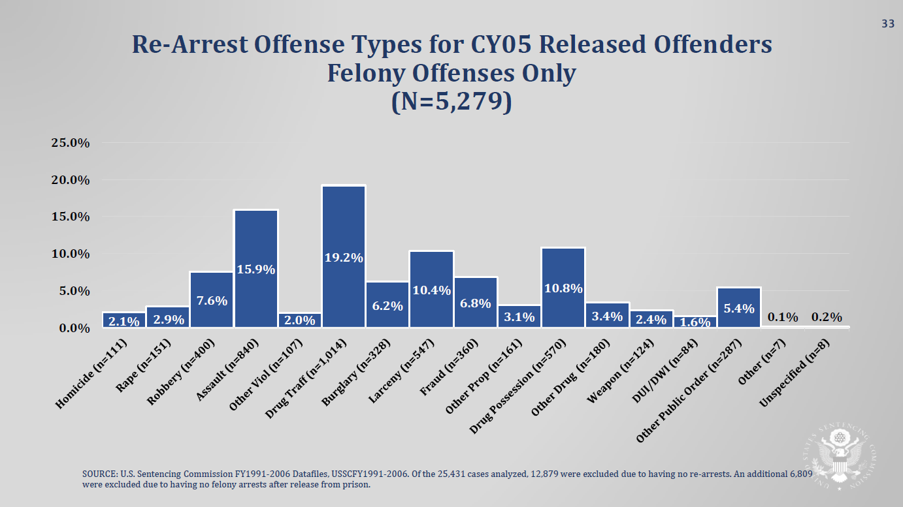
Does Commission’s pending recidivism study answer those questions?
All offenders. Not just drug offenders with mandatory mins.
Not reconviction
So Commission’s report doesn’t tell us rate at which drug offenders who served mandatory sentences committed violent crimes upon release, or what type of violent crimes they committed.

Slide 18
But Congress and the public need to know --
Is it true that released drug traffickers are especially likely to commit violent crimes?
Or not?

Slide 19
Sentencing Reform & Corrections Act of 2016

Slide 20
28 U.S.C. §995: Powers & duties of U.S. Sentencing Commission
(12) establish a research and development program within the Commission for the purpose of—
(A) serving as a clearinghouse and information center for the collection, preparation, and dissemination of information on Federal sentencing practices; and
(B) assisting and serving in a consulting capacity to Federal courts, departments, and agencies in the development, maintenance, and coordination of sound sentencing practices;
(13) collect systematically the data obtained from studies, research, and the empirical experience of public and private agencies concerning the sentencing process;
(14) publish data concerning the sentencing process;
(15) collect systematically and disseminate information concerning sentences actually imposed, and the relationship of such sentences to the factors set forth in section 3553(a) of title 18, United States Code;

Slide 21
Uses for the Commission research we have
Sentencing Advocacy

Slide 22
In an advisory sentencing system, what judges have done becomes just as persuasive as what the Guidelines say they ought to do.

Slide 23
Therefore, data on what judges have done with defendants similar to defendant at bar becomes potentially powerful.

Slide 24
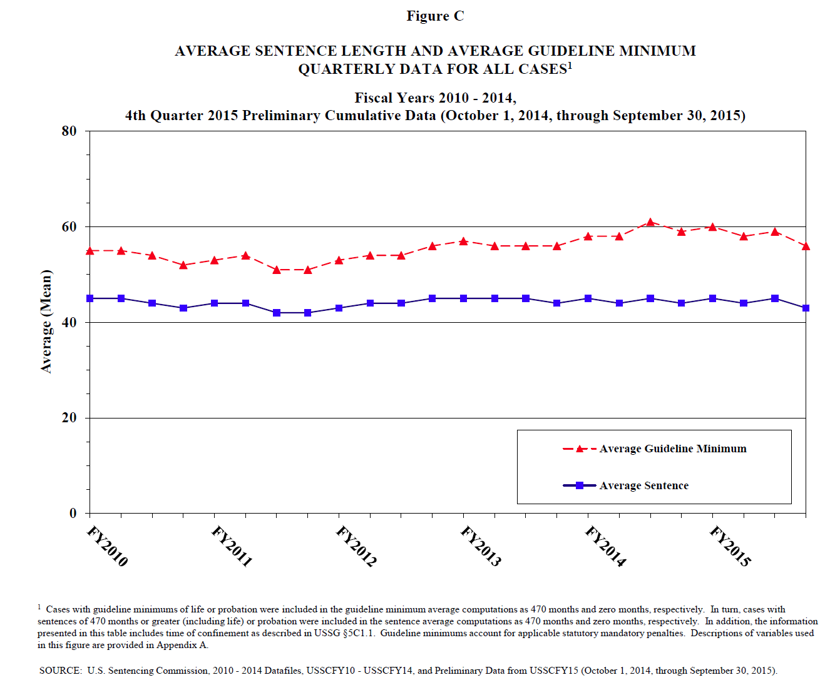
Guidelines remain important…
And therefore mastery of the Guidelines remains critical to competent advocacy.

Slide 25
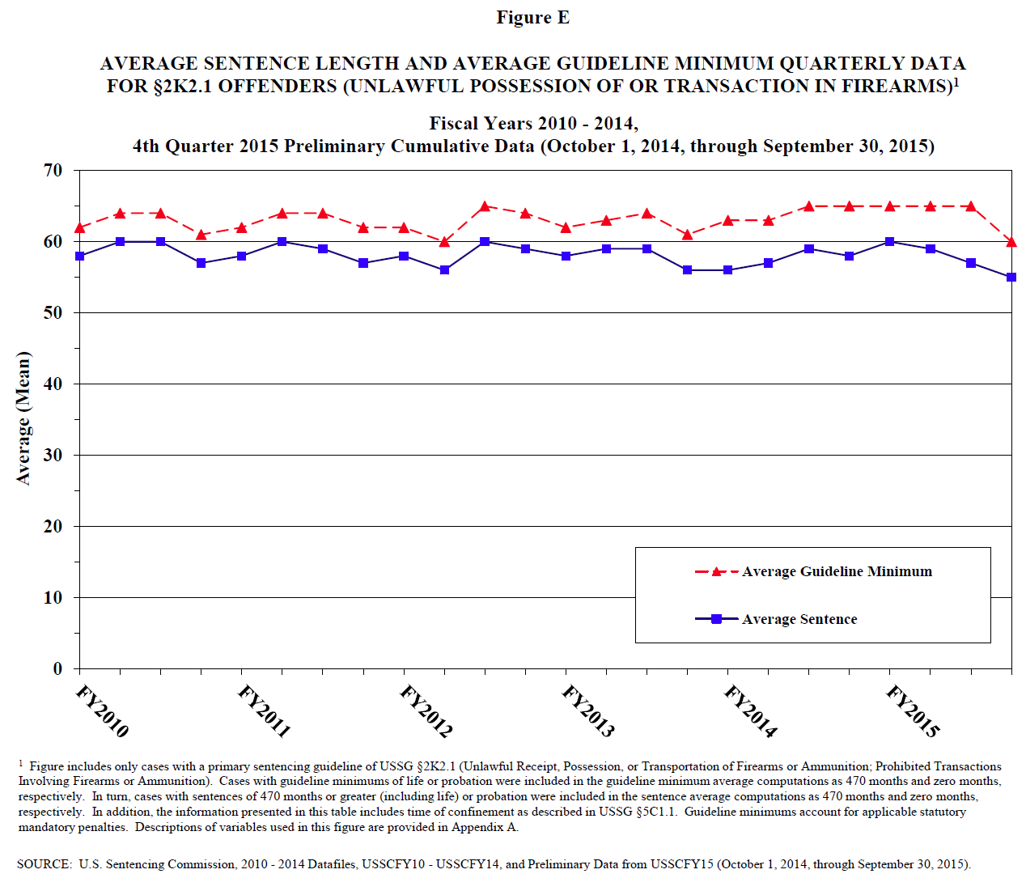
But Guidelines have more influence in some kinds of cases than in others.
Firearms

Slide 26
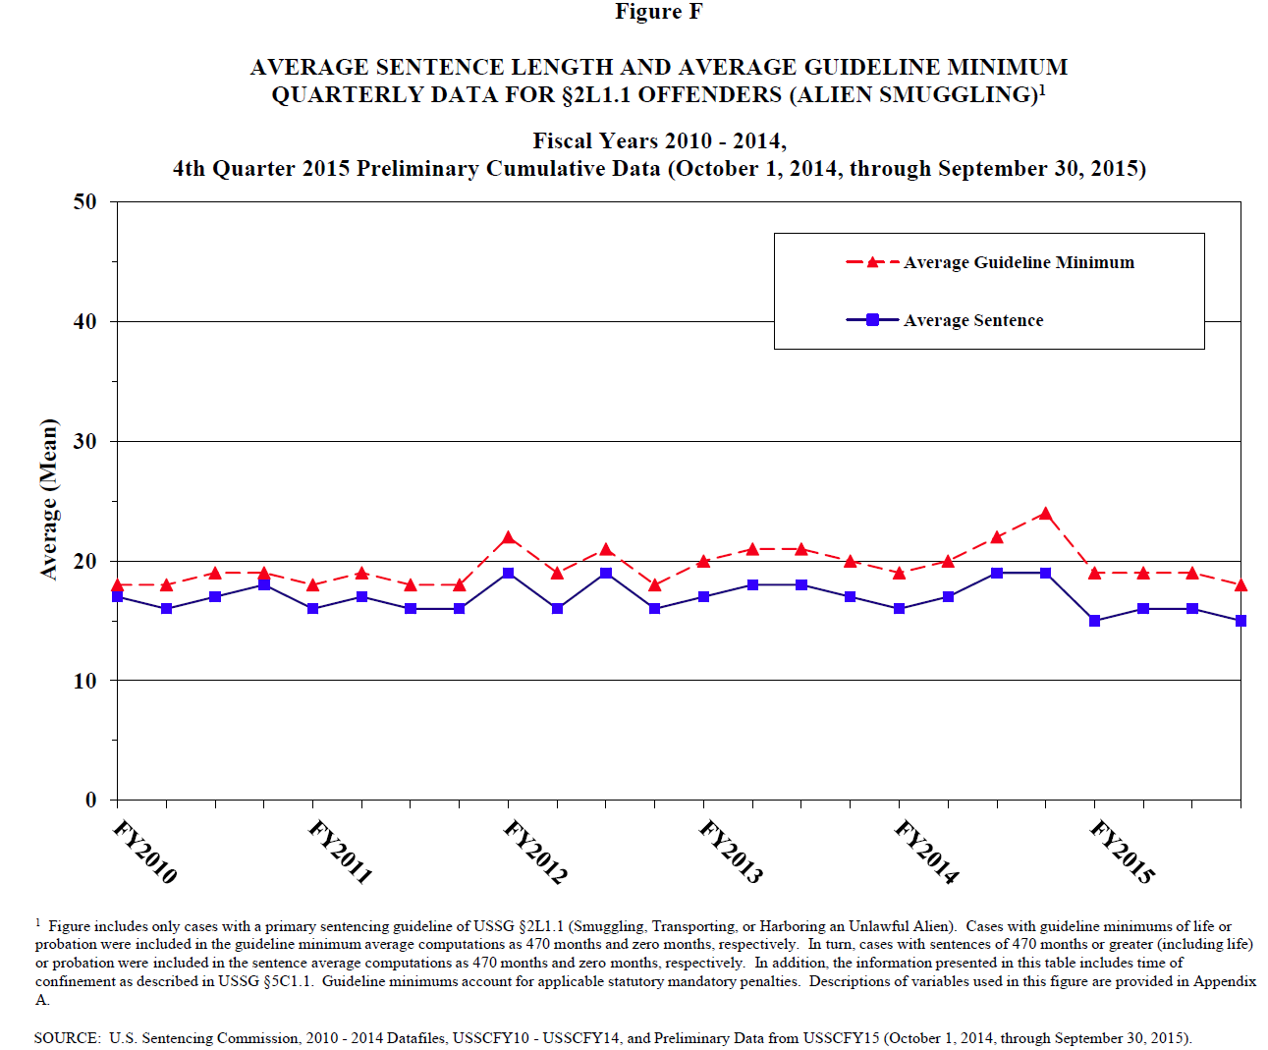
Guidelines have more influence in some kinds of cases than in others.
Alien smuggling

Slide 27
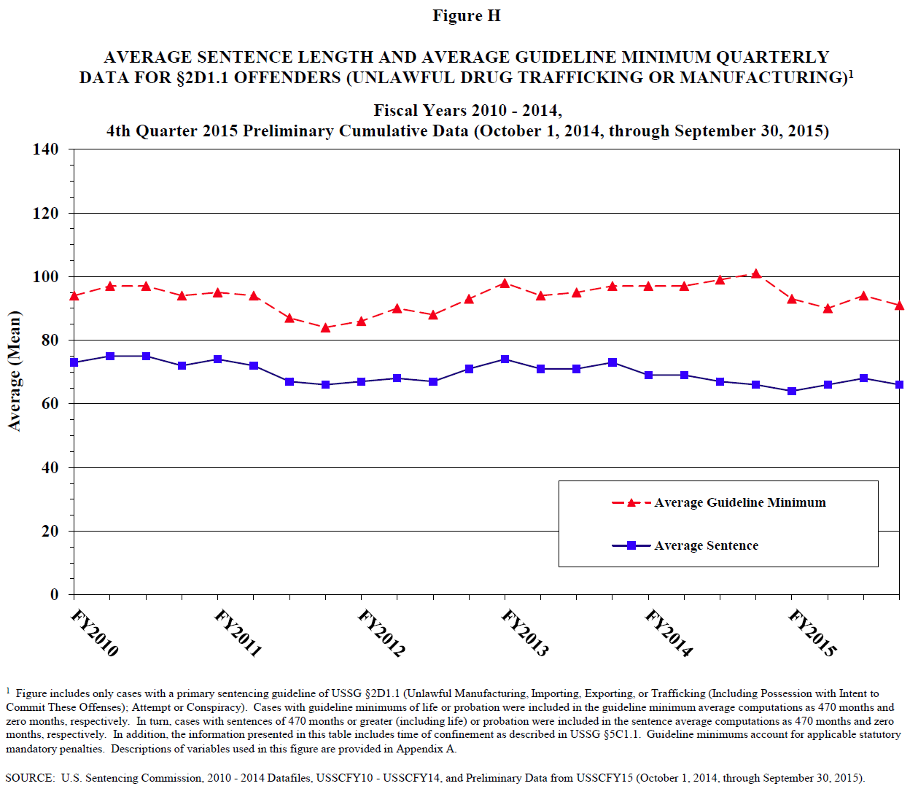
Guidelines have more influence in some kinds of cases than in others.
Drugs

Slide 28
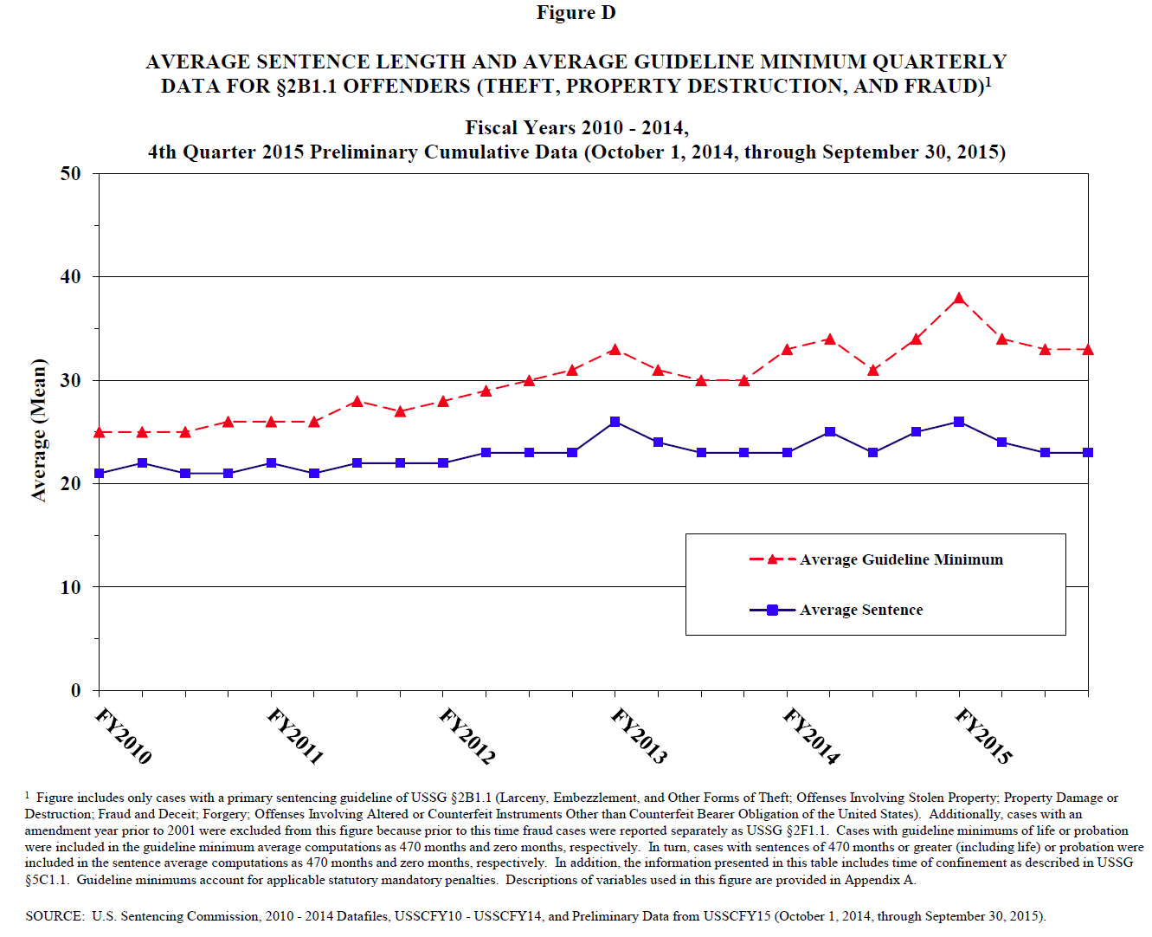
Guidelines have more influence in some kinds of cases than in others.
Economic crime

Slide 29
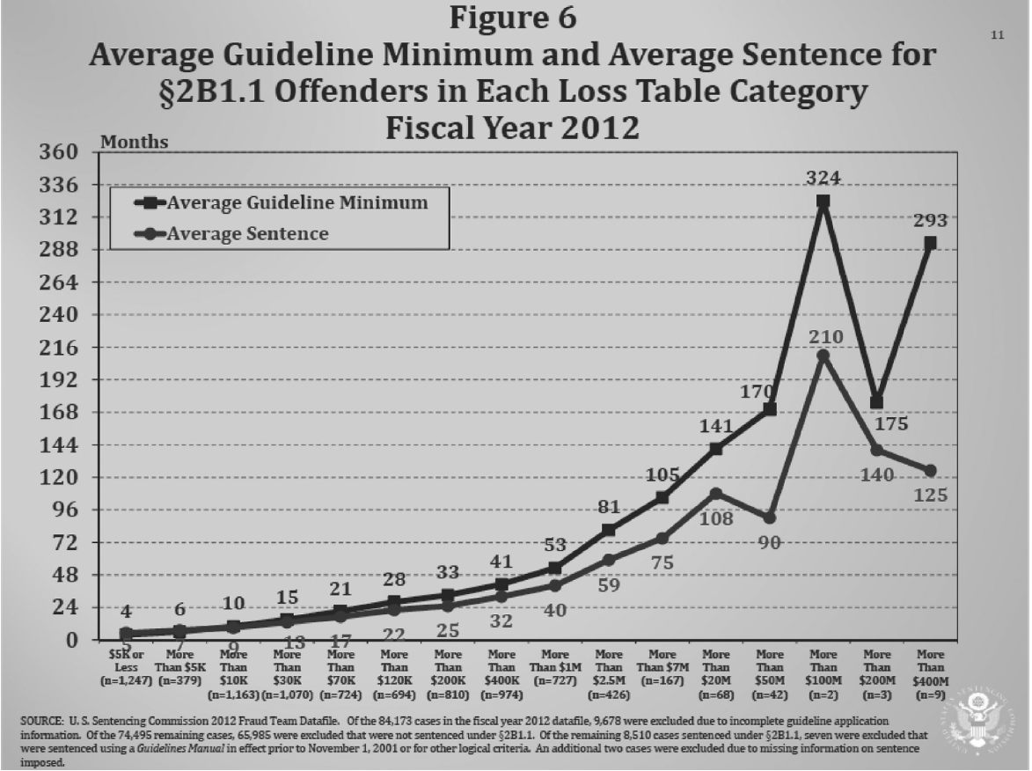
Economic Crime Cases

Slide 30
But these statistics are very general. How can I use statistics to compare my individual defendant to similarly situated others?

Slide 31
How to individualize arguments based on data…
Everyone: Become familiar with data sources
Judges
Ask the Commission – they work for you
AUSAs
Defense counsel
Use Federal Defenders resources…

Slide 32
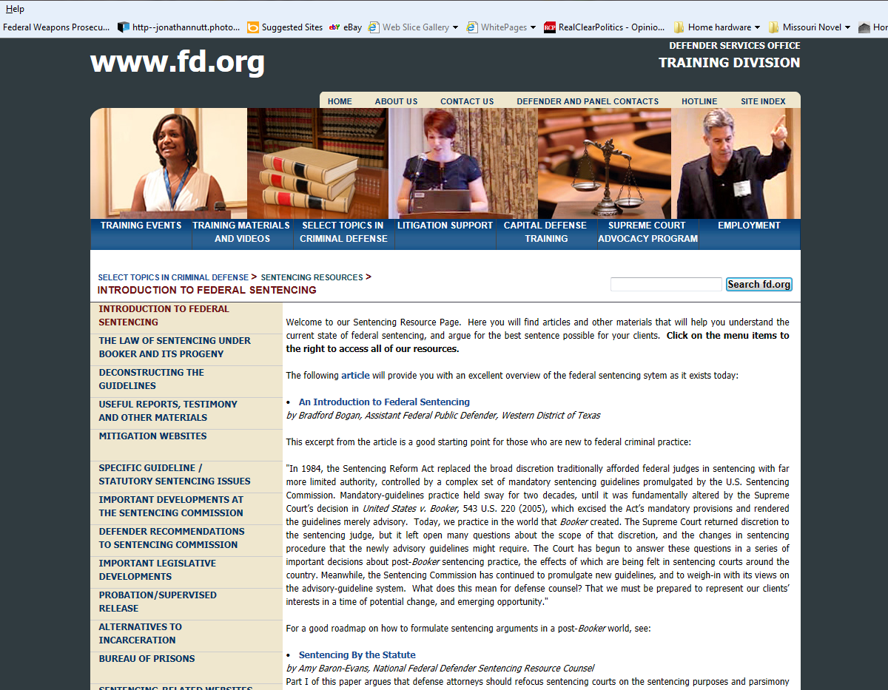
Use Federal Defender website

Slide 33
Use resources Federal Defender Resource Counsel has prepared

Slide 34
Call Federal Defender Sentencing Resource Counsel
While they can’t do it for every case, they have some capacity to do statistical analyses for individual cases

Slide 35
PRIVATE COUNSEL: If your client has the funds, there are private data analysts who will do individualized data runs for comparable cases

Slide 36
EVERYONE: Be lawyers Be creative
Use data as raw material to craft arguments

